Slide 1
ABC Company’s new Franchise Analysis
Introduction/Business Problem :
ABC company is one of the major chain of stores in Europe who specializes in selling art/craft items. They also sell antique items and replicas of historical artifacts.
The company has their franchises all over Europe and all of them have been really successful. Now the company wants to expand their business and decided to venture in to the customer base in USA.
Since this is their first attempt in entering US market, they want to explore all the options and make sure that this is really successful. But the problem is either the marketing team or the Analyst team are not aware of the US customer base.
So they decided to engage a consulting firm (XYZ Consulting Inc) in the US who specializes in Business consulting and Data Analytics field.

Slide 2
Introduction/Business Problem - continued
The ABC company shared all the details about their stores and their budget constrains. The expectation from the XYZ analysts is to recommend them where they can open their first store to make sure they have best shot at being successful.
I, Data Scientist from XYZ decided to go with top down approach. So first I had to chose the city for their first store. There were many potential cities which were involved in my analysis.
Since their products are mainly arts and antique artifacts, opening the store in places like Las Vegas doesn’t make sense as the customers in Las Vegas are mostly tourists who like gambling and partying. So I decided to go with the cities with museums as the people who visit museums are most likely to be interested in ABC company’s products.

Slide 3
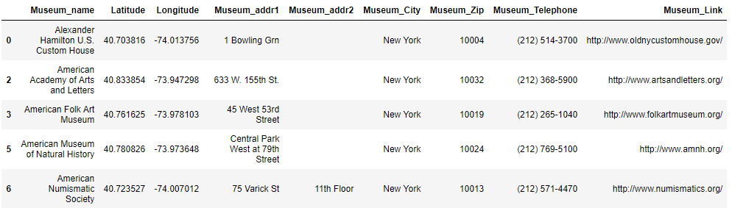
Data :
The main contenders were Chicago, New York, Washington DC etc. The first city I choose for my analysis was New York. This was an obvious choice as there are more number of museums in New York than any other cities in USA.
I downloaded the New York Museums data from Wikipedia. Below is a snapshot of the data.

Slide 4
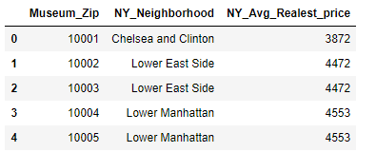
Data - continued
This data contains list of all NY city museums and corresponding address, telephone and URL. The data also contains latitude and longitude information for each museum. This will help me in getting the nearby venues using Foursquare API.
I also downloaded the real estate price($)/square feet for each zip code/neighborhood within New York city limits. Since my client ABC company has budget constrains as well, this will help me to identify affordable place to rent for their store. Below is a snapshot of the data.

Slide 5
Data - continued
The real estate price for each zip code can be merged with the museum data along with the nearby venues collected by calling Foursquare API. I can implement clustering algorithm on this combined data. The clusters created can be analyzed further to identify top spots/neighborhood for opening the ABC company store.

